Slide 1
MATtrackerGPS System Overview
Review of concept and future opportunities

Slide 2


Overview
MATtrackerGPS is an economical and robust asset tracking system providing locating data on high value assets.
The system utilizes both an on-site mesh-network and GPS technology to quickly identify assets.
MTGPS uses a simple to navigate, multi-platform user interface allows for identification of assets in seconds.

Slide 3


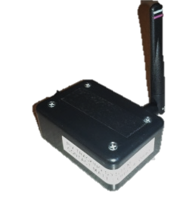
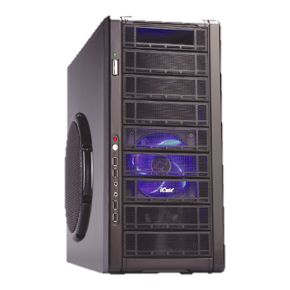
System Overview – Mesh Network
USB-DRS/PC
Interface
Stationary Mesh Network Radios
Mobile Mounted PIV Radios
2.4 Ghz Zigbee Range Wi-Fi Network Signal
Data
Retention System
8/27/2018
3

Slide 4
MATtracker
MATtracker is the compete solution that maximizes Asset Locating capabilities and automates several manual processes related to PIV operations
Additional Capabilities also provided by MATtracker
Ability to track who is operating PIV
Ability to control who is operating PIV
Ability to control when the PIV is operated
Daily Inspection Checklists (OSHA requirement)
Automated Hour Meter entry and understand utilization
Crash/Bump detection
One Point Lessons at PIV
Request for Repairs
PM/Repair notification interface
Robust Node Reader Construction for heavy manufacturing environment
Track routes used for pick up and delivery
GPS option for external tracking

Slide 5




MATtrackerGPS
Easily searchable interface
Dynamic Filtering
Multi-Platform System
Mobile Phones
Tablets
Workstations
Customizable Interface

Slide 6
MATtrackerGPS System Overview
Review of concept and future opportunities

